Slide 1
Session 1: MS Excel Advanced
Duration: 3 Hours
Notes:
Highlights: Introduce yourself and the session.
Key Takeaways: NA

Slide 2
Session Overview
Advanced Excel
At the end of this session, you will be able to:
01
02
03
04
05
Implement Lookup Functions Like Vlookup, Hlookup, Match, and Index.
Use Text Functions Like Left, Right, Mid, Upper, Lower, and Proper.
Implement Date Functions Like Datevalue, Timevalue, Today, Now, Networkdays, and Networkdays.intl.
Implement Advanced Sort and Filter.
Summarize and Customize the Data with Pivot Tables.

Slide 3



Advance Functions in MS Excel
Advanced Excel
Hi Maria, Today, we will learn about some complex functions in MS Excel.
Which functions we are going to learn?
Lookup, Text, and Date functions!
Hi John, Good Morning!

Slide 4

Lookup Functions
Advanced Excel
Lookup functions in Excel mean referencing a cell to match values in another row or column against the cell and thereby retrieving the corresponding results from the respective rows and columns.

Slide 5
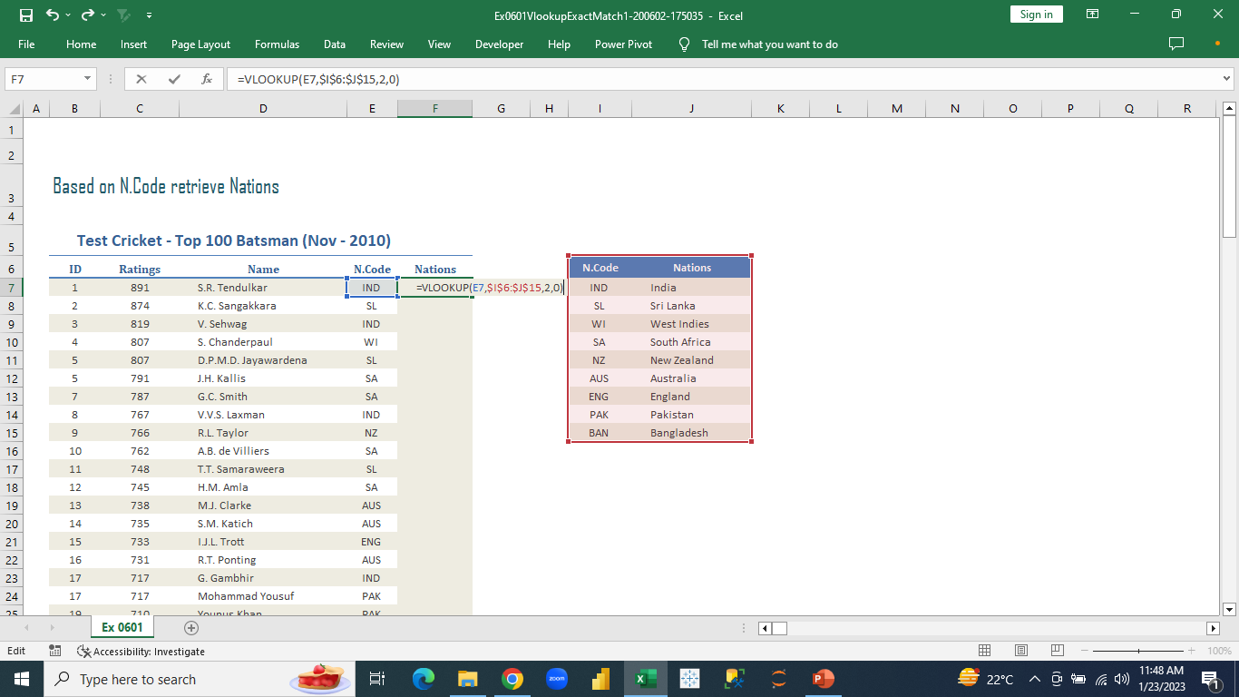
Lookup Functions
Advanced Excel
We need to bring the nations’ names from the right table to the left table in “Nations” column corresponding to the “n.code” column in left table.
Notes:
In the “nations” column in left table we write the formula “ =vlookup(E7,$I$6:$J&15) “ and click enter. We drag the formula down for the rest of the entries in the column.

Slide 6
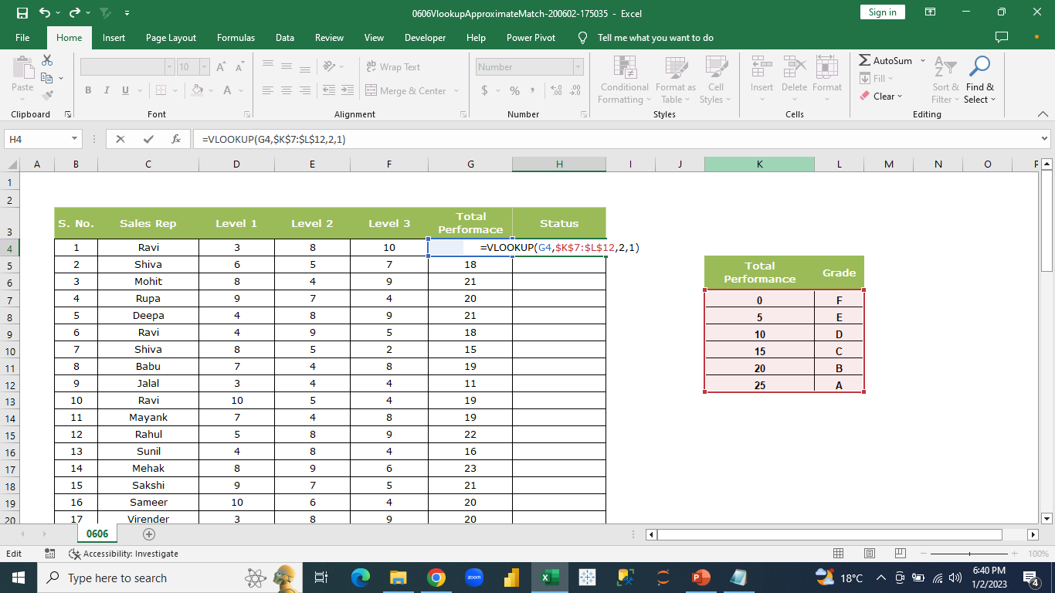
Lookup Functions
Advanced Excel
We will grade the total performances in the left table based on the grading of the ranges in the right table.
Notes:
In the “status” column in left table, we write the formula “ =vlookup(G4,$K$7:$L$12,2,1)” and click “enter”. We can drag the formula for the rest of the column.

Slide 7
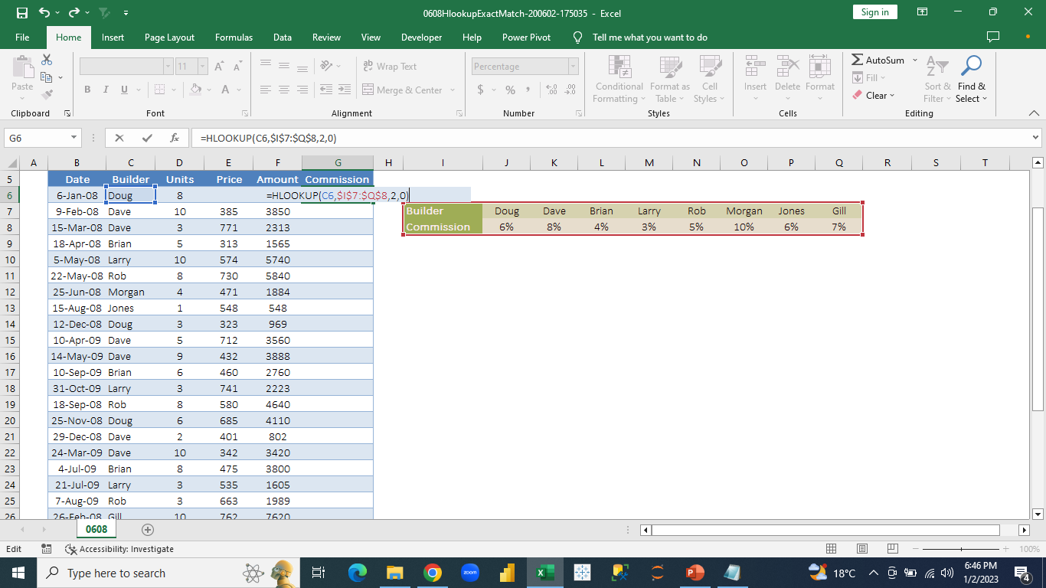
Lookup Functions
Advanced Excel
We want to retrieve the commission % from the right table where the records are placed horizontally to the left table in the “commission” column corresponding to the “builder” columns in left table.
Notes:
In the “commission” column, we use the formula “=hlookup(C6,$I$7:$Q$8,2,0) “ and click enter. We can drag it down for rest of the entries in the column.

Slide 8
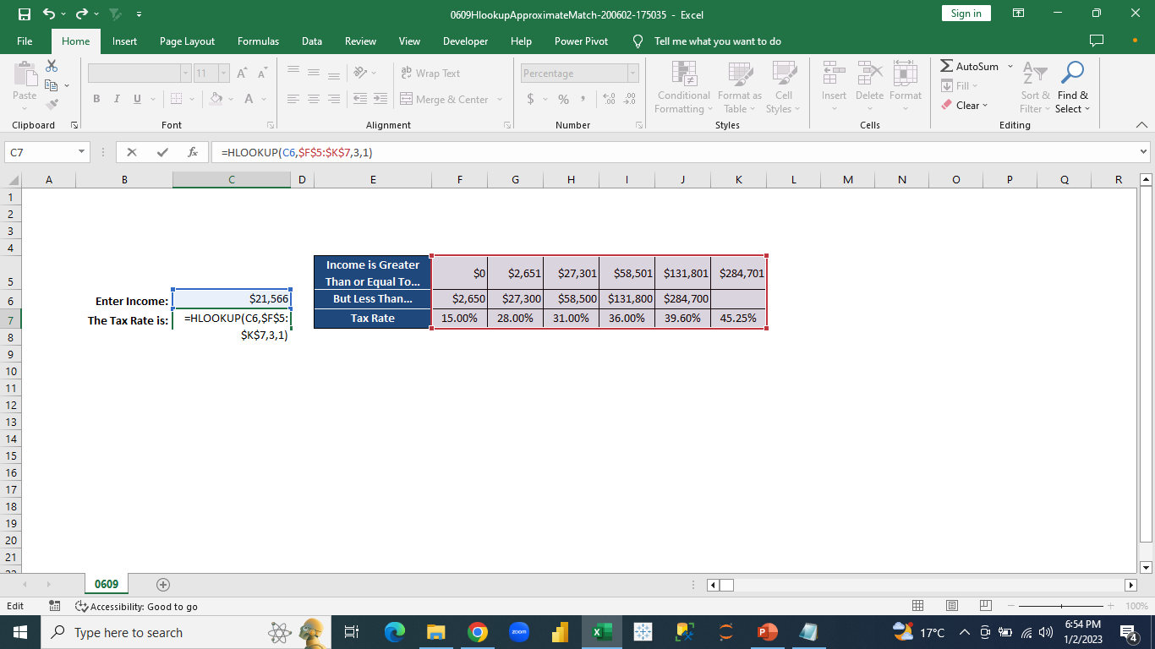
Lookup Functions
Advanced Excel
We need to enter the Tax Rate for the income we enter from the right table that contains the Income ranges for different tax rates.
Notes:
Based on the particular income amount mentioned we need to get the tax rate. We apply the formula “=hlookup(C6,$F$5:$K$7,3,1)” and click enter. We get the required tax rate for the income amount mentioned .

Slide 9

Text Functions
Advanced Excel
Functions that are applied to text/string data like upper, lower, concatenate, mid, left, right, length, text to columns, etc.

Slide 10
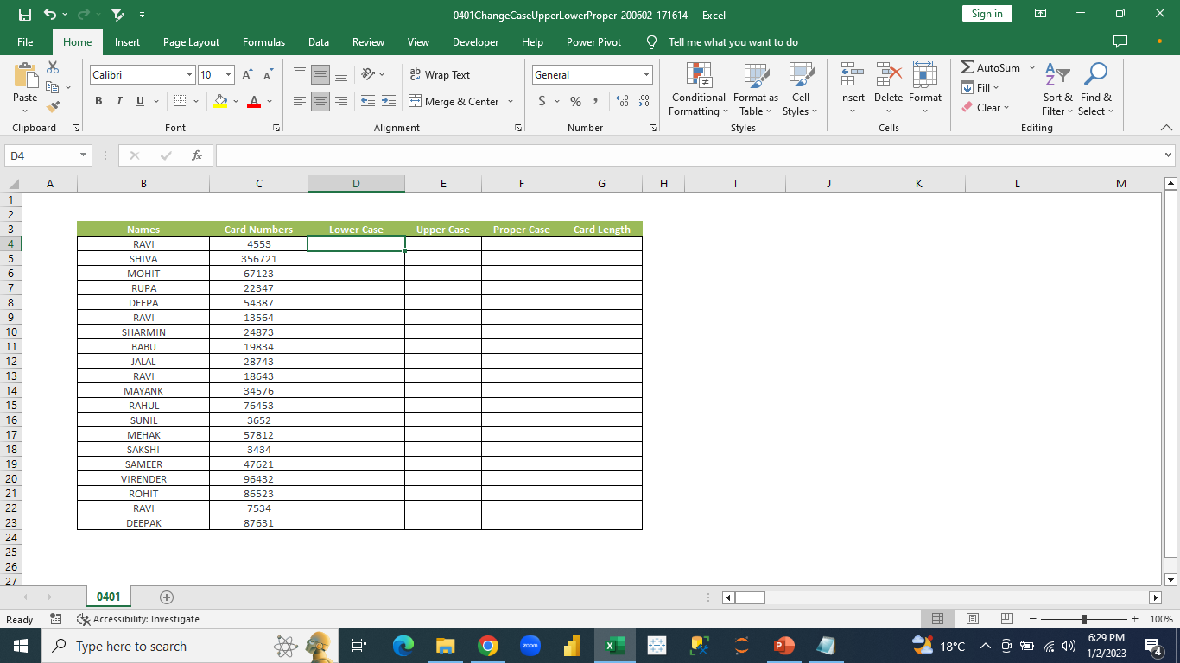
Text Functions
Advanced Excel
We have the dataset where we will perform some text functions.
Notes:
In the dataset, we have two columns – Names and Card numbers. Names are written as text and card numbers as numbers.

Slide 11
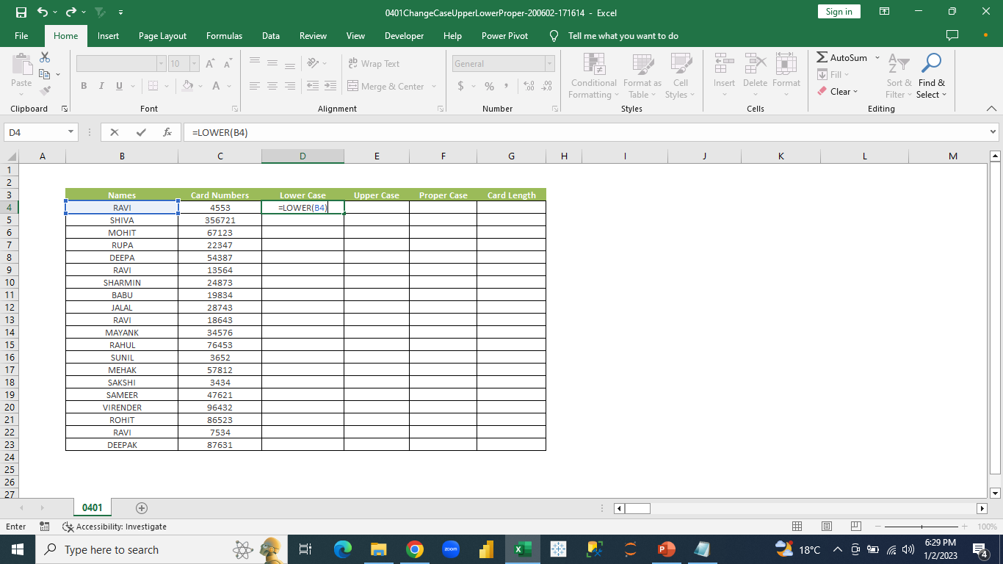
Text Functions
Advanced Excel
We will use text function lower() to represent the names in lowercase.
Notes:
In the lower case column we will use the formula “=lower(B4)” and press enter.

Slide 12
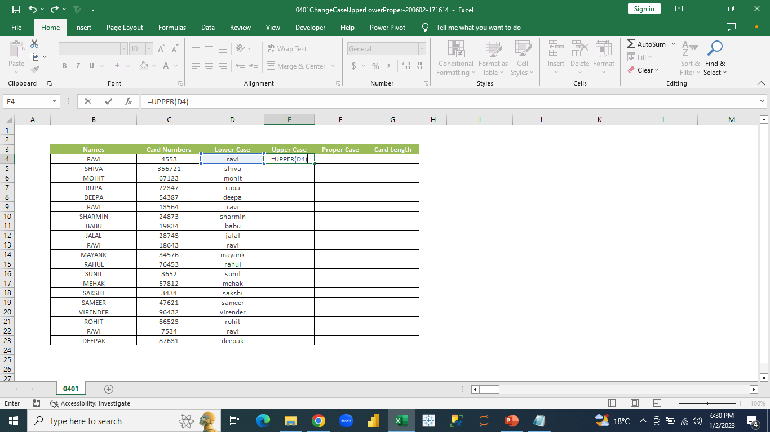
Text Functions
Advanced Excel
We will represent the lowercase names in uppercase.
Notes:
In the upper case column, we will use the formula “=upper(D4)” and click “enter”. We drag the rest of the formula down to the rest of the cells in the column.

Slide 13
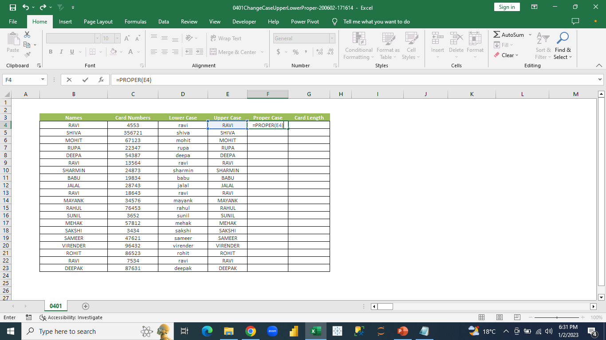
Text Functions
Advanced Excel
We will represent all the names in proper case.
Notes:
In the proper case column, we will use formula “=proper(E4)” and click “ok”. We drag the rest of the formula down to the rest of the cells in the column.

Slide 14
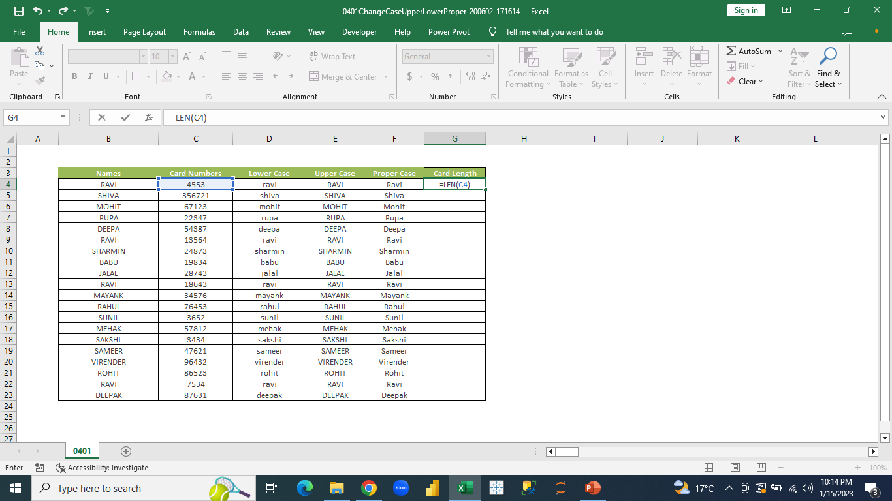
Text Functions
Advanced Excel
We will find the length (number of digits) of each card number.
Notes:
In the card length column, we use the function “=len(C4)” and click “ok”. We drag the rest of the formula down to the rest of the cells in the column.

Slide 15
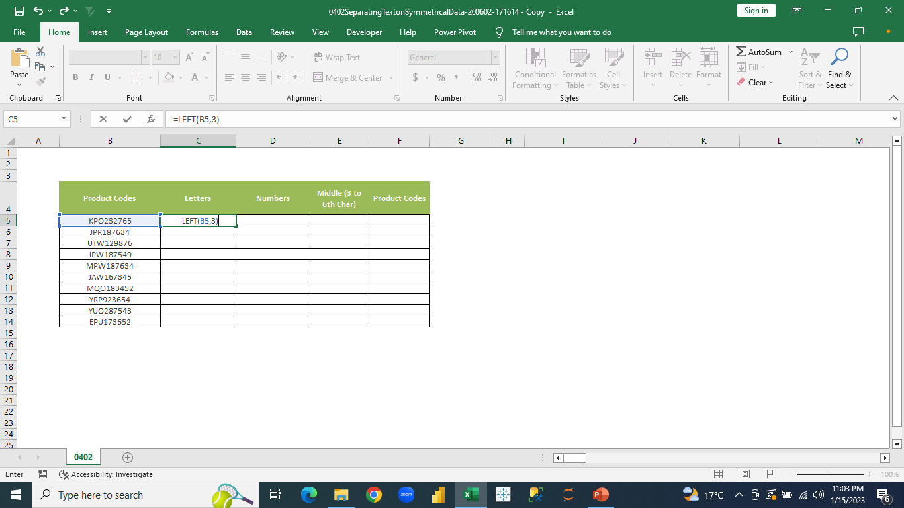
Text Functions
Advanced Excel
We try to get the first three characters from the left side of each product code from the “Product Codes” column.
Notes:
In the letters column, we write the formula “=left(B5,3) and click “ok”. We drag the rest of the formula down to the rest of the cells in the column.
We get three characters from the left of each code.

Slide 16

Text Functions
Advanced Excel
We try to get the first six characters from the right side of each product code from the “Product Codes” column.
Notes:
In the letters column, we write the formula “=right(B5,6) and click “ok”. We drag the rest of the formula down to the rest of the cells in the column.
We get six characters from the right of each code.

Slide 17
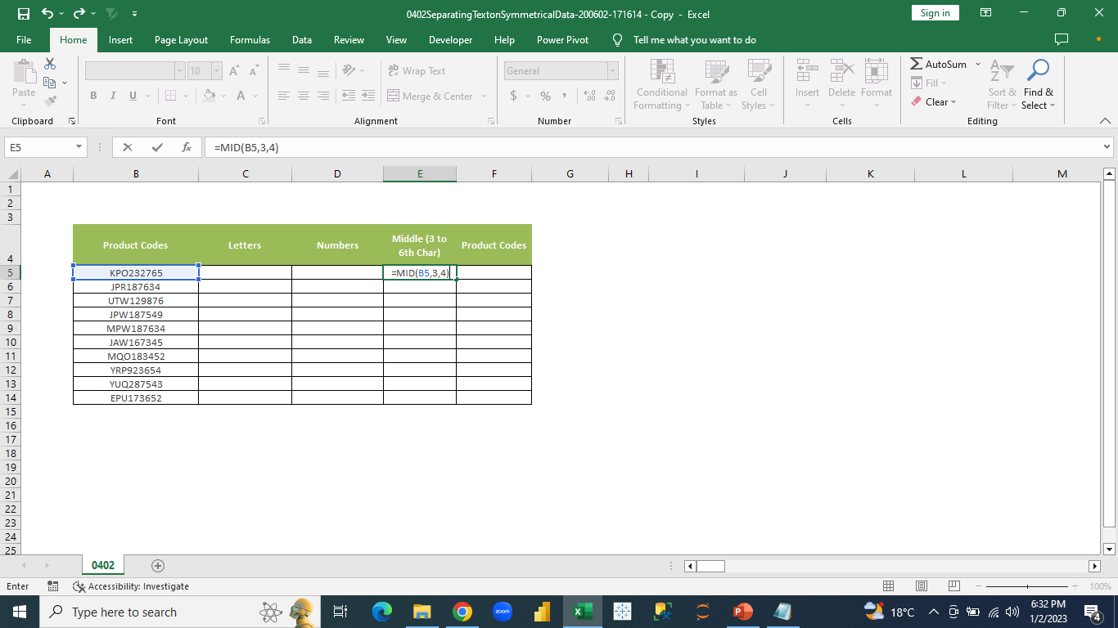
Text Functions
Advanced Excel
We try to get 3rd to 6th characters from the middle of the product codes in the “Product Codes” column.
Notes:
In the letters column, we write the formula “=mid(B5,3,4)” and click “ok”. We drag the rest of the formula down to the rest of the cells in the column.
We get characters starting from 3rd position and total of 4 characters to the right of each code.

Slide 18

Date Functions
Advanced Excel
We use different date functions to get more information on dates in our data. The functions used here are:
now()
today()
datevalue()
timevalue()
networkdays()
networkdays.intl()

Slide 19
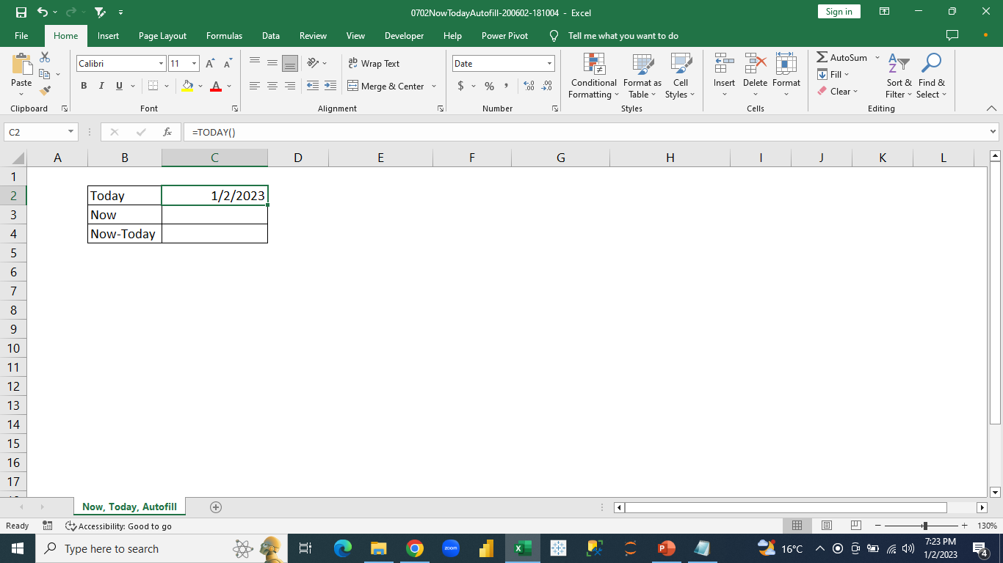
Date Functions
Advanced Excel
We need to display the current date in the worksheet.
Notes:
We use the formula “=today()” and press enter to get the current date

Slide 20
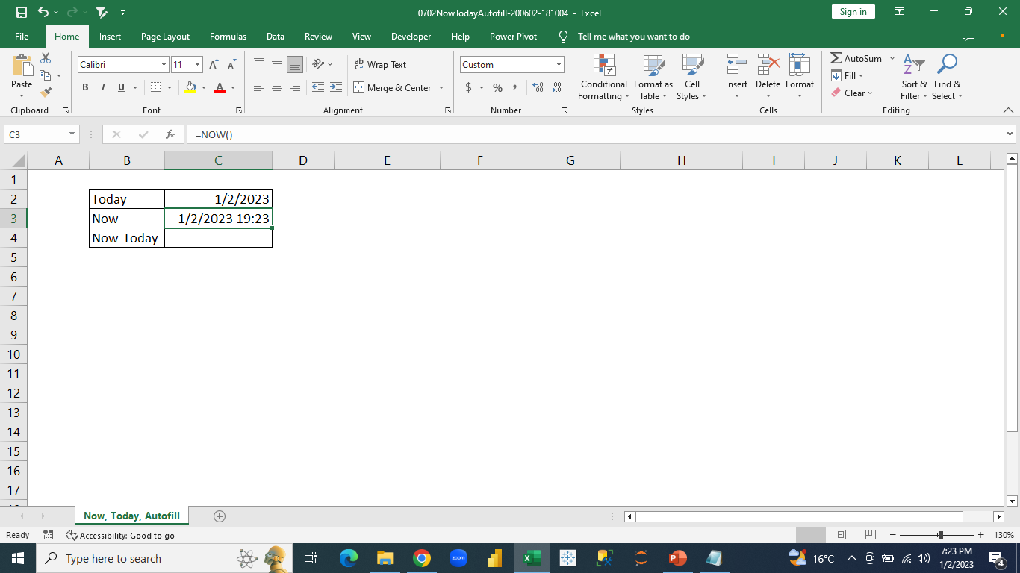
Date Functions
Advanced Excel
We want to get the current date and time in the worksheet.
Notes:
In the worksheet, we type the formula “=now()” and press enter

Slide 21
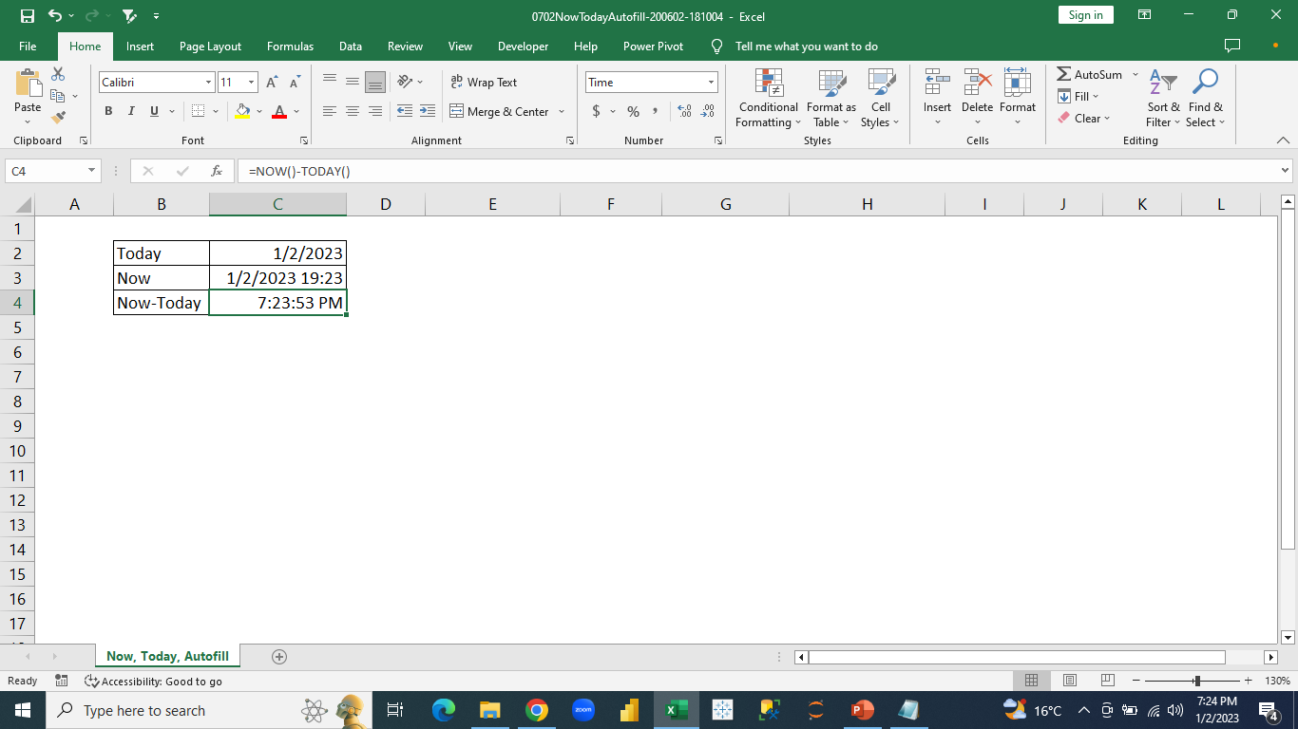
Date Functions
Advanced Excel
We want to display only the current time in the worksheet.
Notes:
In the worksheet, we type “=now()-today()” and press enter .

Slide 22
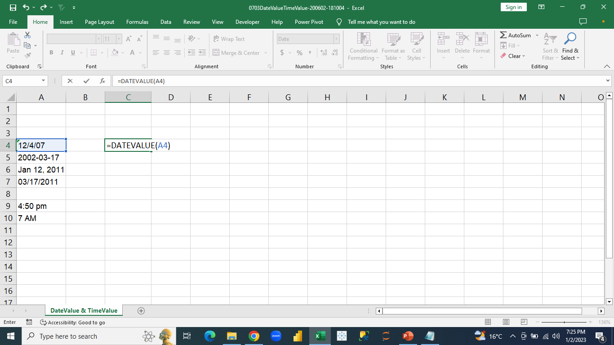
Date Functions
Advanced Excel
We want to set a data which is written in date but not a date in the proper date format.
Notes:
We enter the formula “=datevalue(the text to be converted into date) and press “enter”

Slide 23
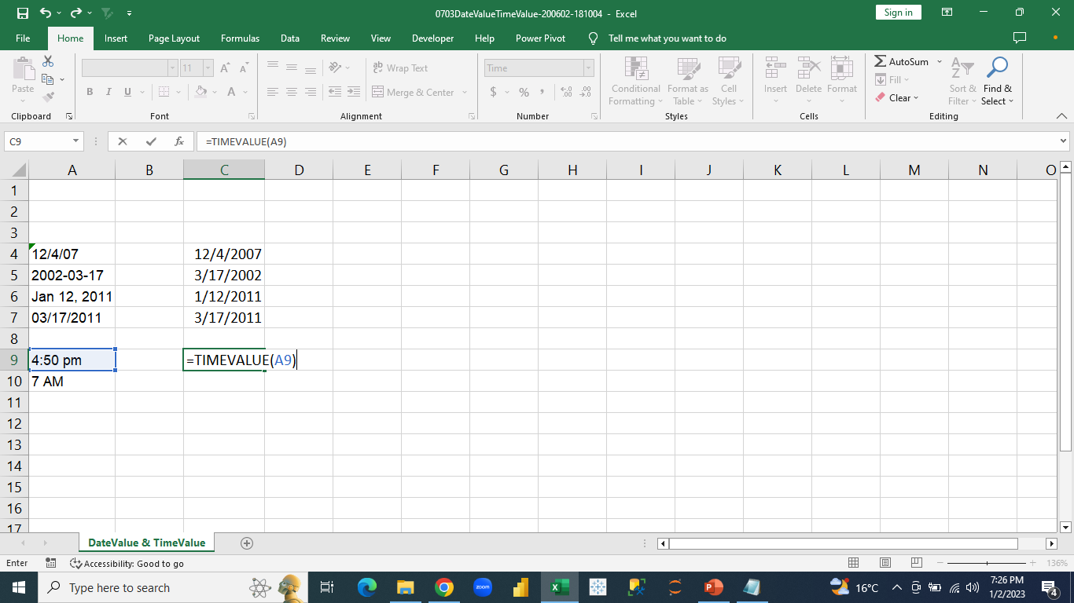
Date Functions
Advanced Excel
We want to display a data written in time but is not actually into a proper time format.
Notes:
We enter the formula “=timevalue(the text to be converted into date) and press “enter”

Slide 24
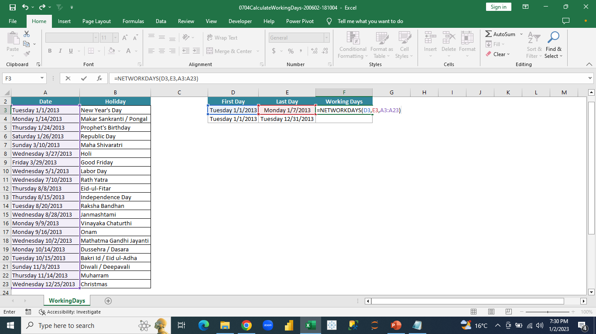
Date Functions
Advanced Excel
We need to get the count of all the holidays from a list of holidays for a given date range.
Notes:
In a cell in worksheet, we type the formula “=networkdays(start date, end date, entire holiday list) and press enter

Slide 25
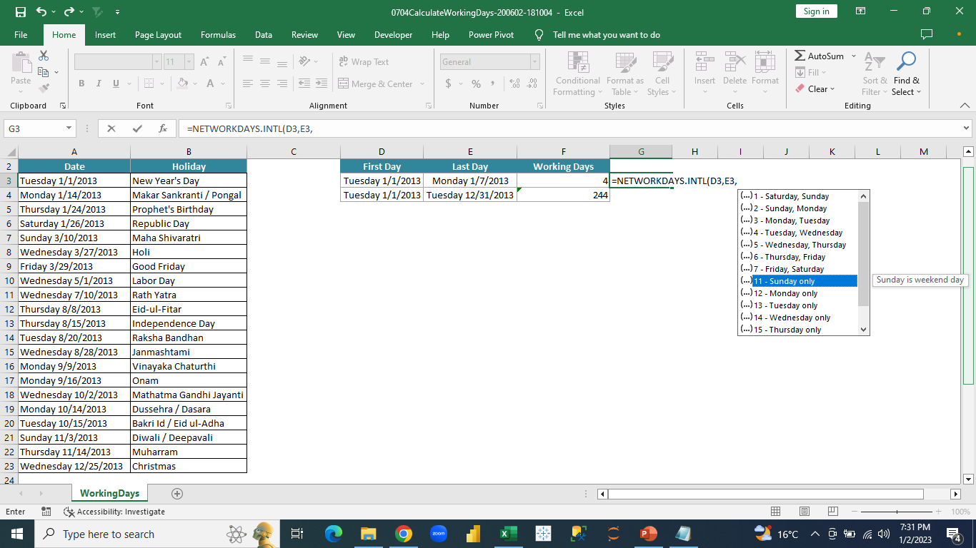
Date Functions
Advanced Excel
We need to get the count of holidays for a date range from a list of holidays including Saturdays (considering only Sunday as holiday).
Notes:
In a cell in worksheet, we type the formula “=networkdays.intl(start date, end date, choose 11 for holiday only on sunday

Slide 26

Date Functions
Advanced Excel
Formula continued from previous slide:
Notes:
=networkday.intl(start date, end date, 11, entire list of holidays) and press enter

Slide 27

Advanced Sorting
Advanced Excel
Apart from basic sorting. we can perform sorting in various ways. It includes:
Custom Sort
Horizontal Sort

Slide 28
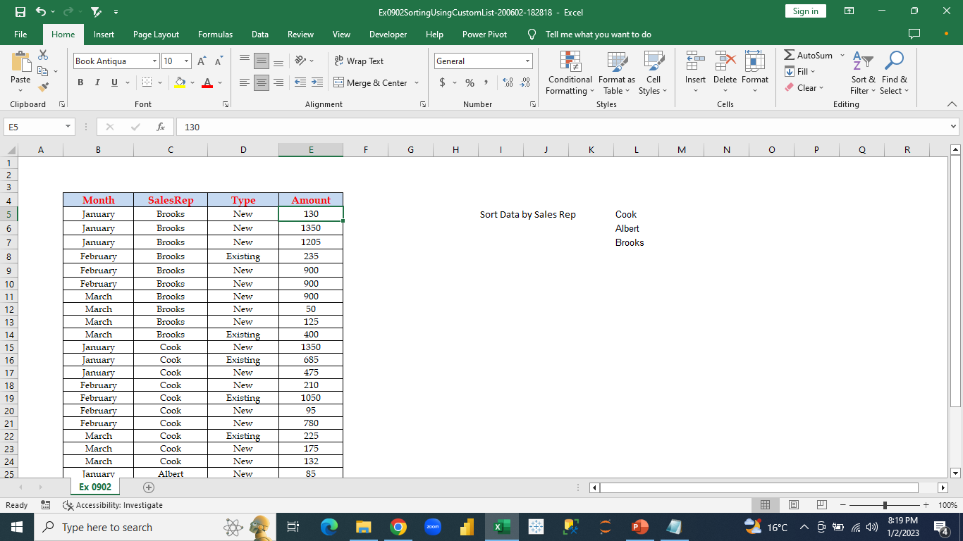
Advanced Sorting
Advanced Excel
We need to sort the SalesRep column based on the order mentioned in the right side for the SalesRep Names.
Notes:
We will sort the column according to the order specified . If we want to do it for the entire data we select the whole data and follow the following steps

Slide 29
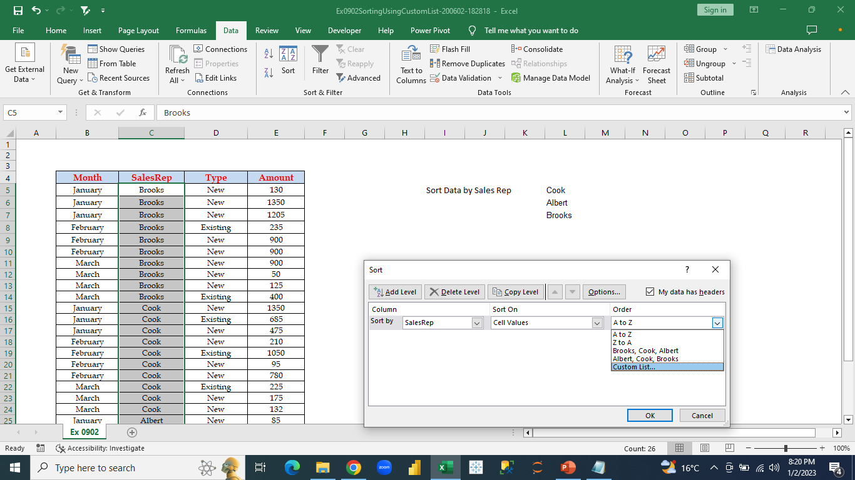
Advanced Sorting
Advanced Excel
We will select the column of SalesRep where we want the sorting to be done.
Notes:
Select the sales rep column -> data menu -> sort option -> in the sort dialog box, we will select the sales rep column in sort by box, cell values in sort on box and in the order box we will select the custom sort

Slide 30
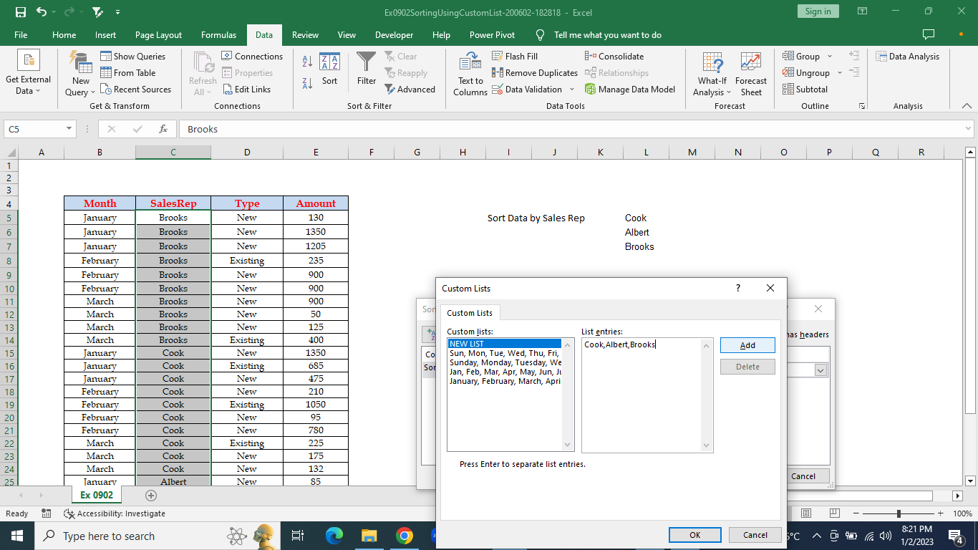
Advanced Sorting
Advanced Excel
We will create a new custom list to be sorted.
Notes:
In the custom list dialog box, select new list -> enter the custom list -> add -> ok

Slide 31
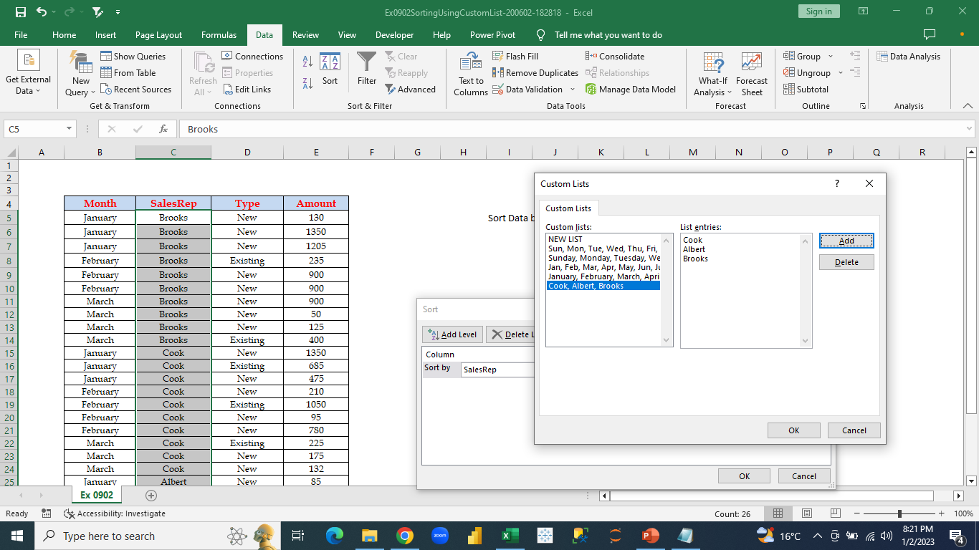
Advanced Sorting
Advanced Excel
The custom list is created in the list box.
Notes:
We can see the custom list in the list section as a newly added custom list in the custom list dialog box

Slide 32
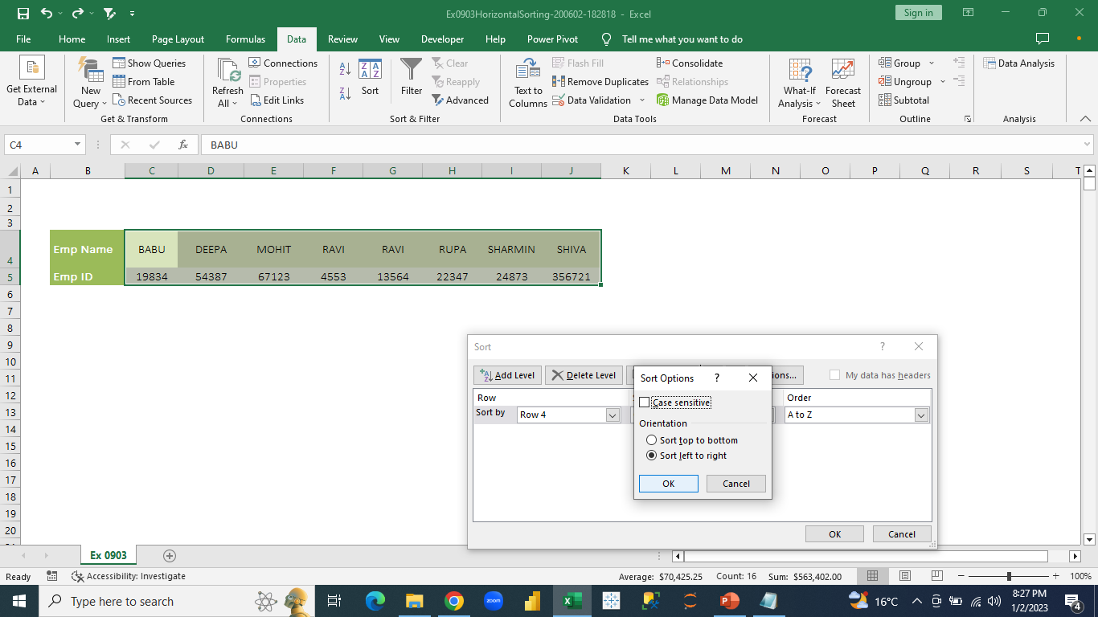
Advanced Sorting
Advanced Excel
We will perform sorting now from left to right (horizontally).
Notes:
Select the data (excluding the header names) -> data menu -> sort -> options button -> sort left to right -> ok

Slide 33
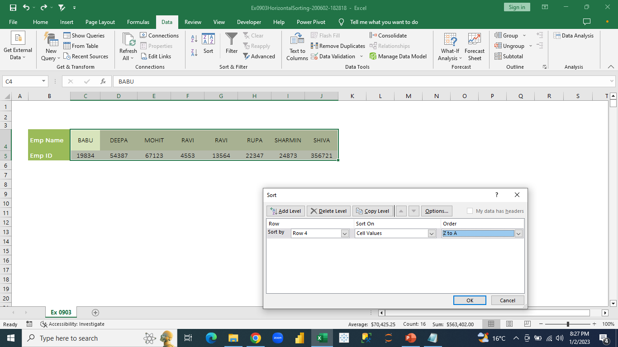
Advanced Sorting
Advanced Excel
After selecting the type of sort, we will select the order of sort (ascending or descending).
Notes:
We will select the row in the sort by box, we will select cell values in sort on box and order as descending (Z to A) -> ok

Slide 34

Advanced Filtering
Advanced Excel
After performing basic filter, we can also filter based on numerous criteria together.

Slide 35
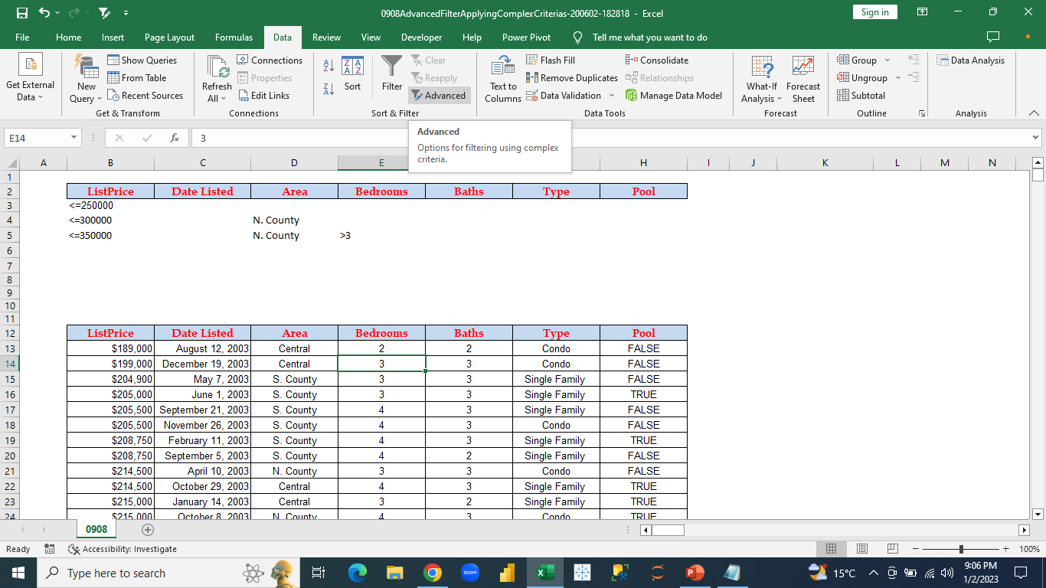
Advanced Filtering
Advanced Excel
From the whole data, we have taken multiple criteria to filter all at once.
Notes:
Data menu -> filter option we select advanced option

Slide 36
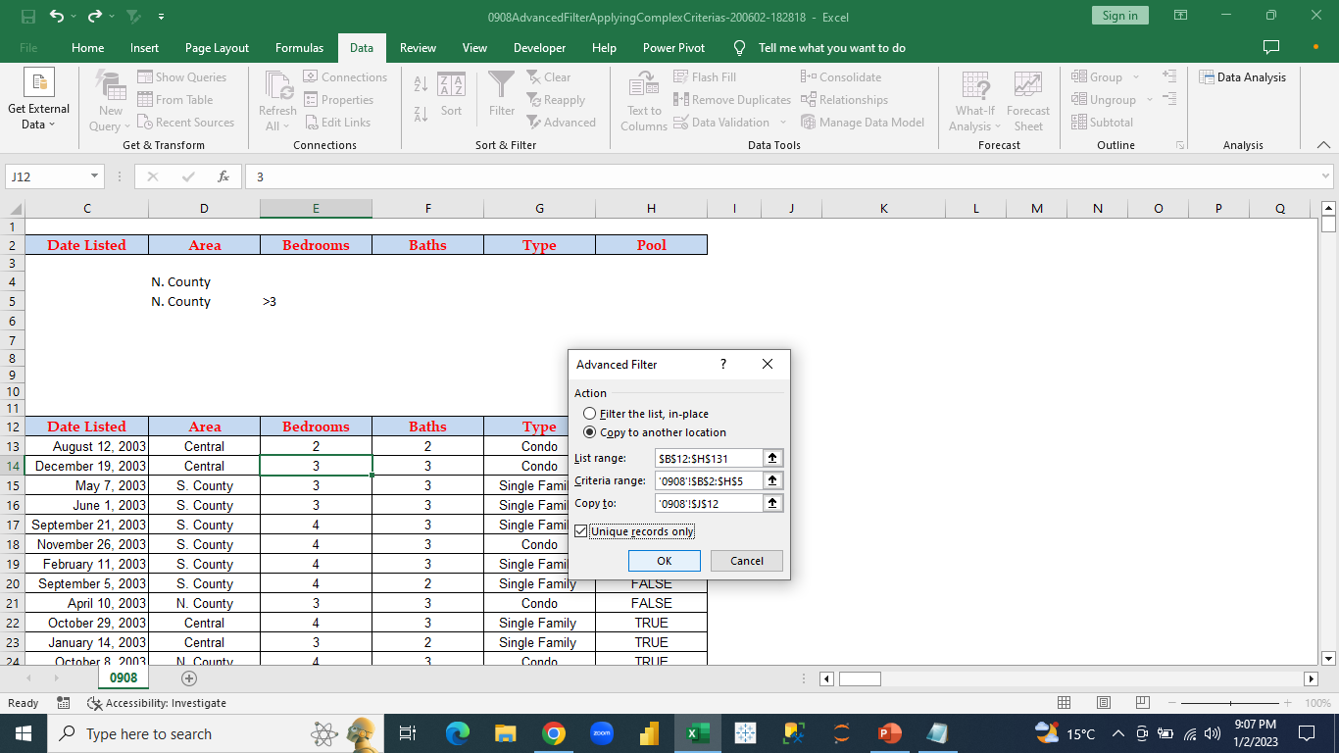
Advanced Filtering
Advanced Excel
“Advanced filter” dialog box appears:
Notes:
We select “copy to another location” -> in the list range we select the whole data -> in the criteria range we select all the criteria -> copy to box we select the location where we want to see the filtered data -> select unique records only option to remove duplicates from filtered data -> ok

Slide 37

Pivot Table
Advanced Excel
A PivotTable is an interactive way to quickly summarize large amounts of data. You can use a PivotTable to analyze numerical data in detail and answer unanticipated questions about your data.
A PivotTable is especially designed for: Querying large amounts of data in many user-friendly ways.

Slide 38
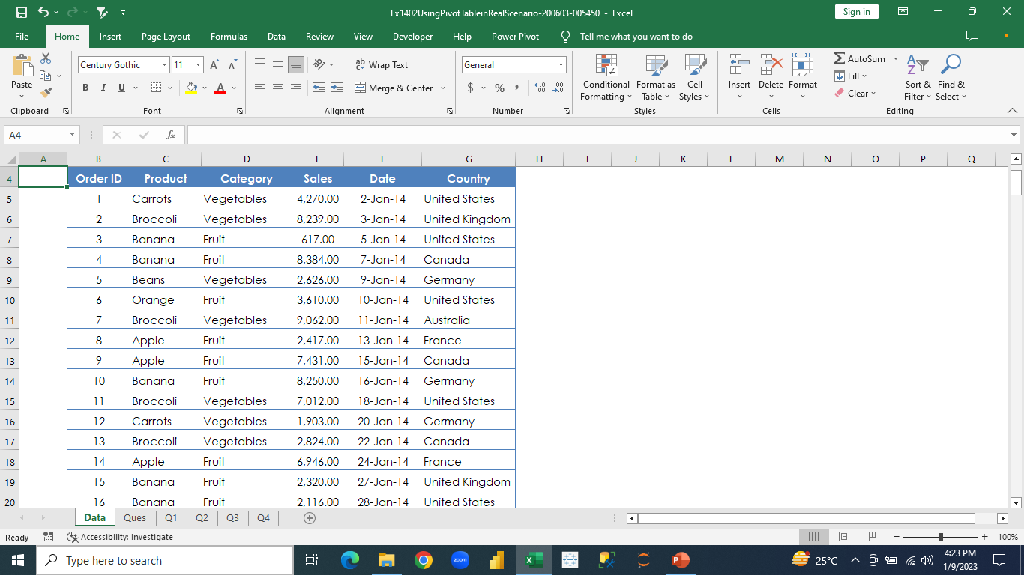
Pivot Table
Advanced Excel
The dataset consists of six columns containing the details of product and the sales of the products.
Notes:
We will work on this dataset for the pivot table analysis.

Slide 39
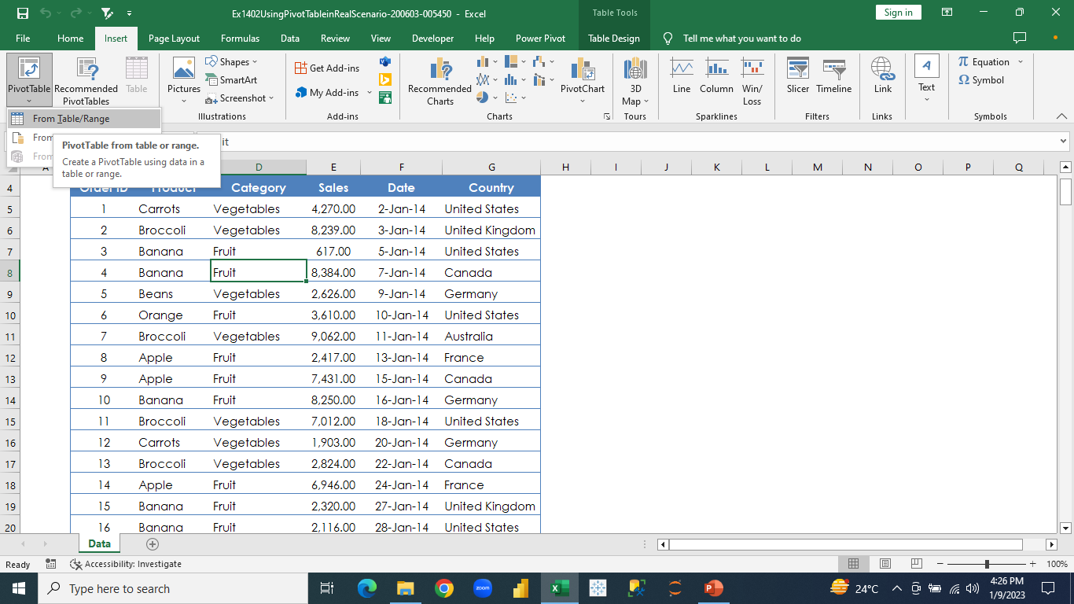
Pivot Table
Advanced Excel
To create a pivot table, we will click on any cell within the table.
Notes:
Insert menu -> pivot table option -> select “from table/range option”.

Slide 40
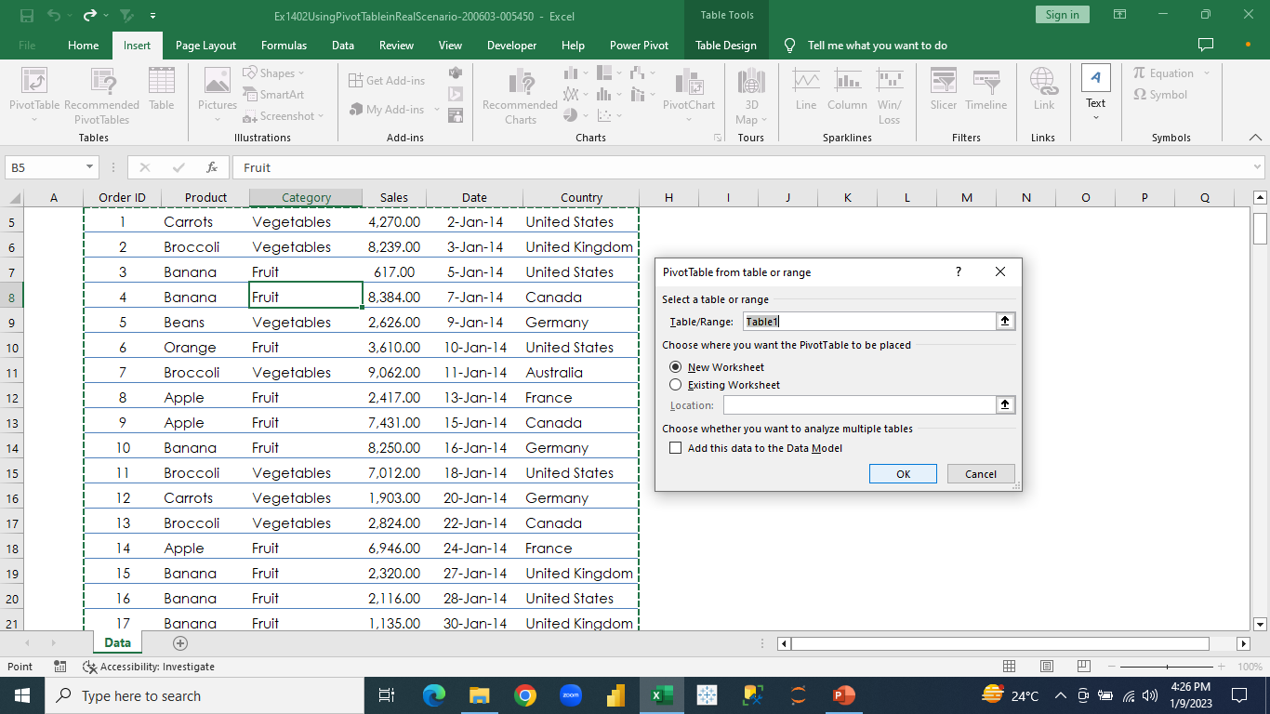
Pivot Table
Advanced Excel
In the Pivot Table dialog box, the table range is selected automatically.
Notes:
We select “new worksheet” option and click “ok”.

Slide 41
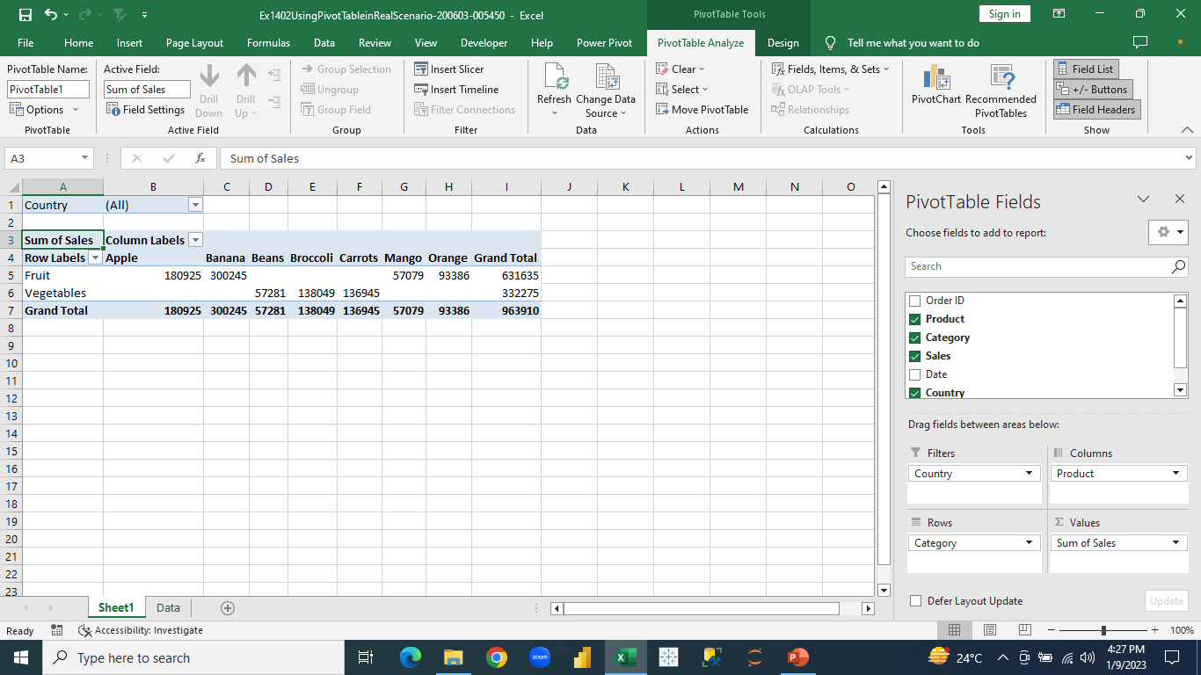
Pivot Table
Advanced Excel
Pivot Table Editor is opened in a new sheet.
Notes:
We can design the table as per our requirements by dragging fields in the four panes: filter, column, row, values. In the filter we drop fields that needs to be filtered, in the rows we drop fields that will be presented row wise in the table, in the columns we drop fields that will be presented column wise in the table and lastly in the values we drop fields that contains only numerical columns.

Slide 42
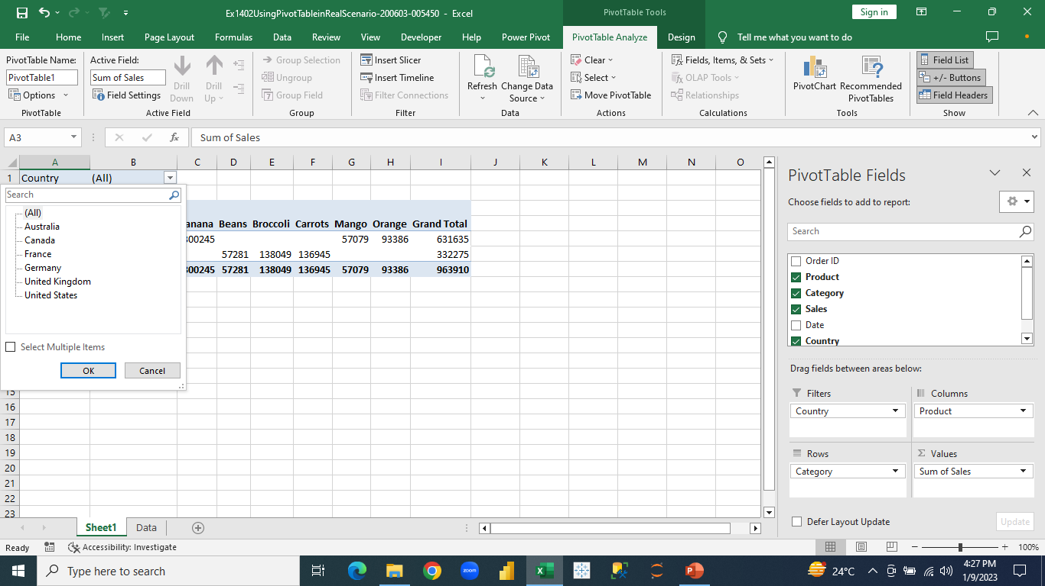
Pivot Table
Advanced Excel
We drop Country in the filter section, Product in the column section, Category in rows section, and Sales in values section.
Notes:
A pivot table is created and in the country filter we can select particular countries for which we want to show the table values.

Slide 43
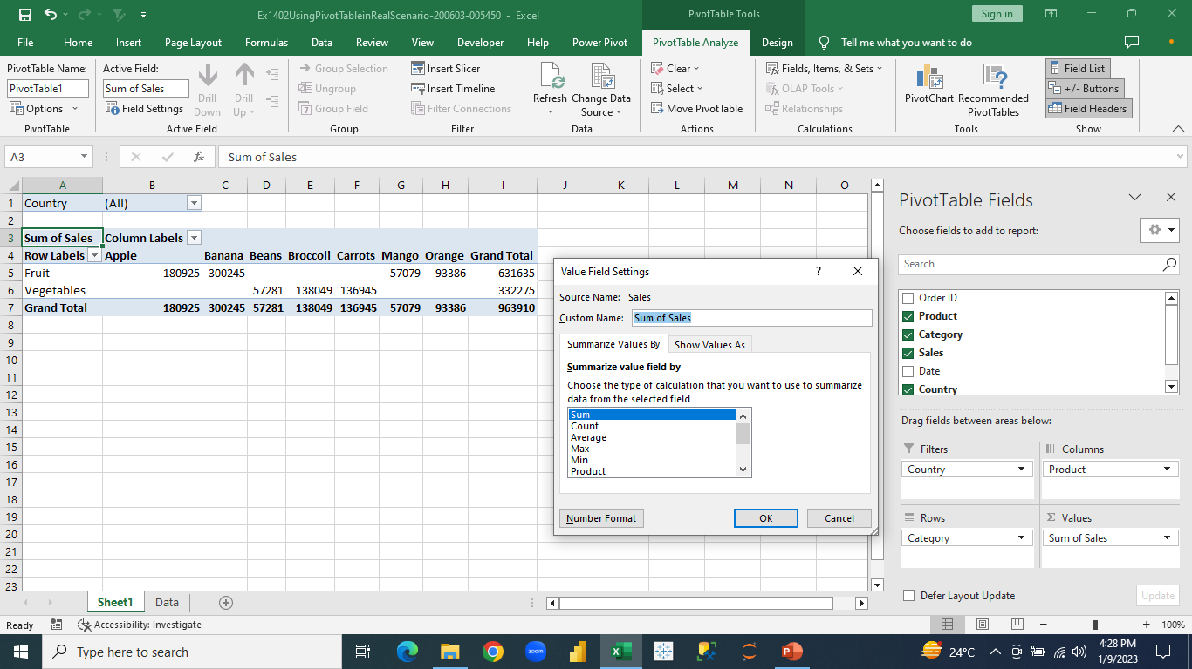
Pivot Table
Advanced Excel
In the fields section, we select the drop-down arrow in the Sales field, and select “Value Field Settings” option.
Notes:
In the “value field setting” dialog box, we can change the aggregation calculation of the sales field to sum, average, count, etc

Slide 44
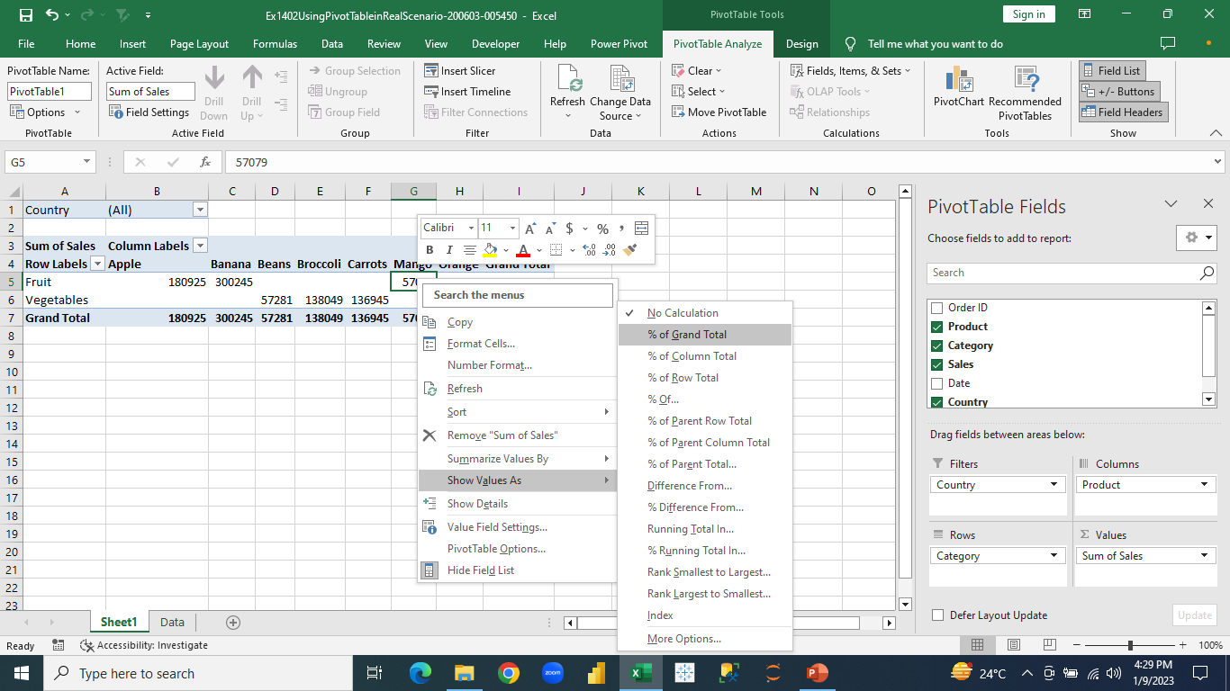
Pivot Table
Advanced Excel
If we want to show the values in the pivot as % out of 100 values, we select the “% of grand total” option.
Notes:
We select on any value in the table, right click and select “show value as” option and from the list of values we select “% of grand total” option.

Slide 45
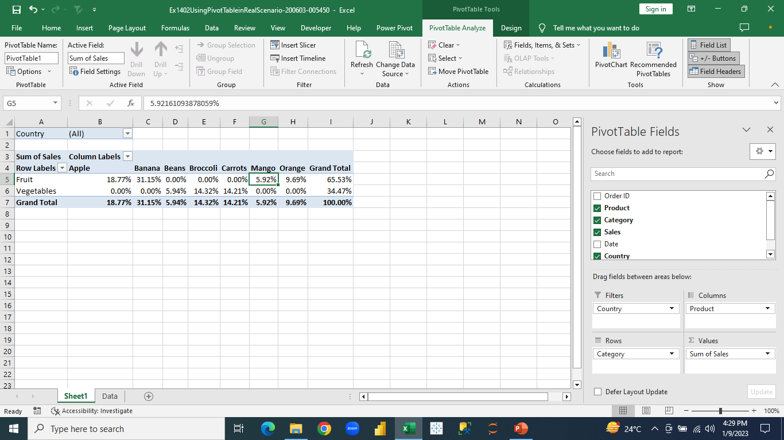
Pivot Table
Advanced Excel
The values are represented as % of grand total representation.
Notes:
The values in the pivot table are presented as out of 100 % how much percent is for each value in the table.

Slide 46

Grouping in Pivot Table
Advanced Excel
You can group pivot table data in order to set it apart from additional subsets of data. You can group most items, but dates are a common item to group.

Slide 47
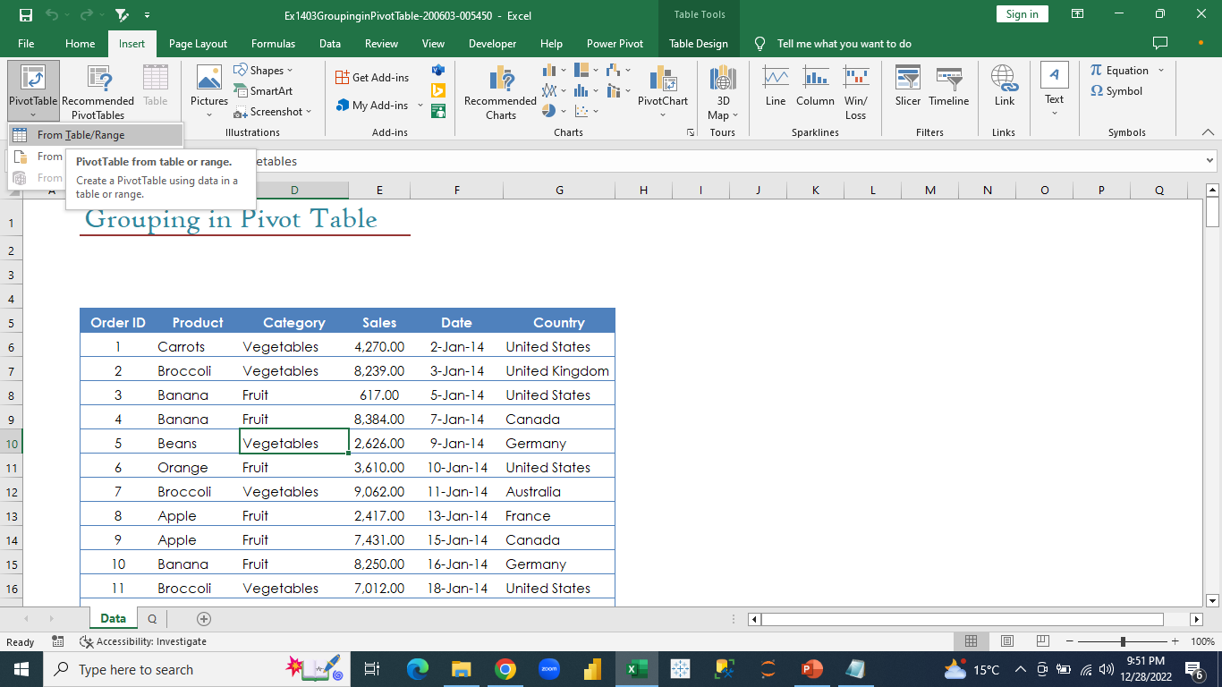
Grouping in Pivot Table
Advanced Excel
We will create a Pivot Table first.
Notes:
Click on any cell inside the table -> insert tab -> pivot table option

Slide 48
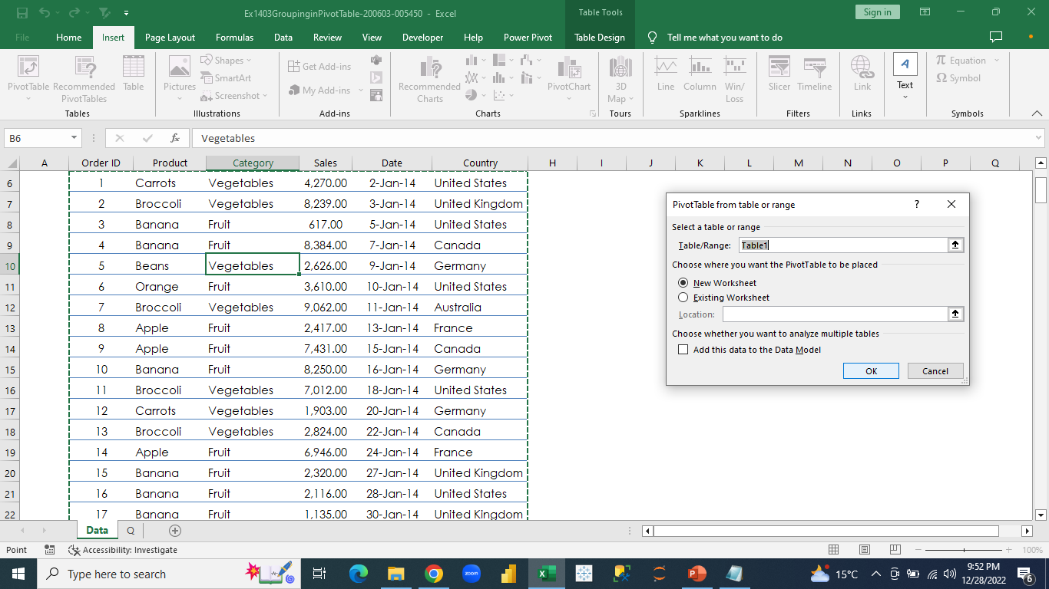
Grouping in Pivot Table
Advanced Excel
We will create a Pivot Table in a new sheet.
Notes:
In the pivot table dialog box, the table range is automatically selected and we will choose “new worksheet” option and click “ok”

Slide 49
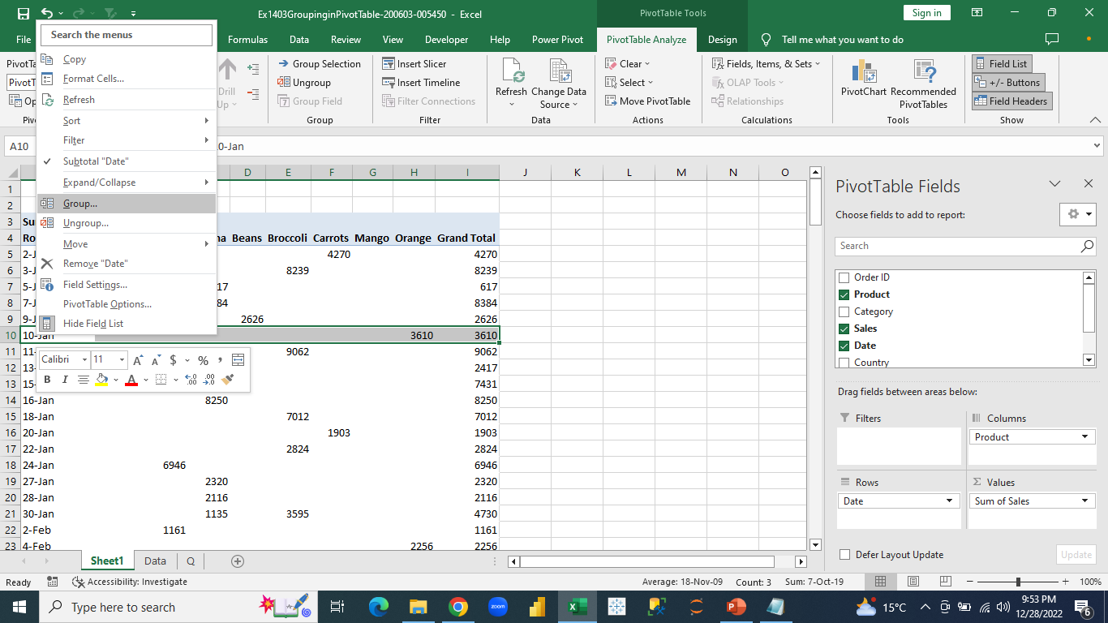
Grouping in Pivot Table
Advanced Excel
We will group a table based on months.
Notes:
Drag product column in columns section -> date column in rows -> and sales column in values. The pivot table is created, we will select any date in the table and right click and choose “group” option

Slide 50
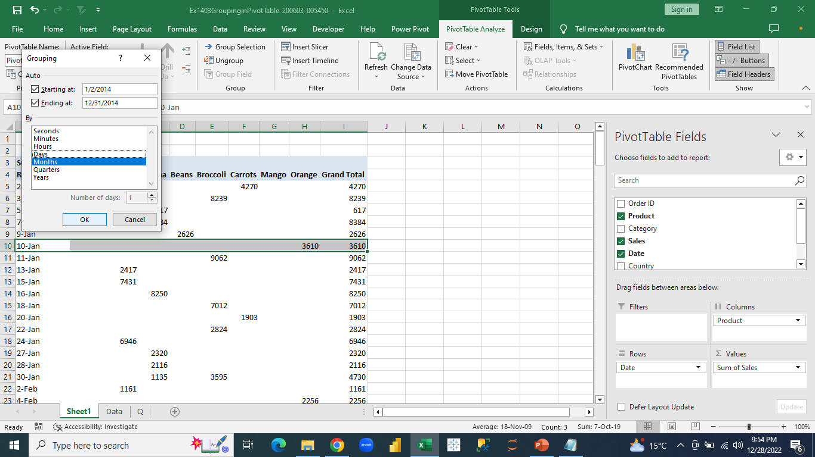
Grouping in Pivot Table
Advanced Excel
A “grouping” dialog box appears:
Notes:
We will select the grouping type which is “month” and will click “ok”

Slide 51
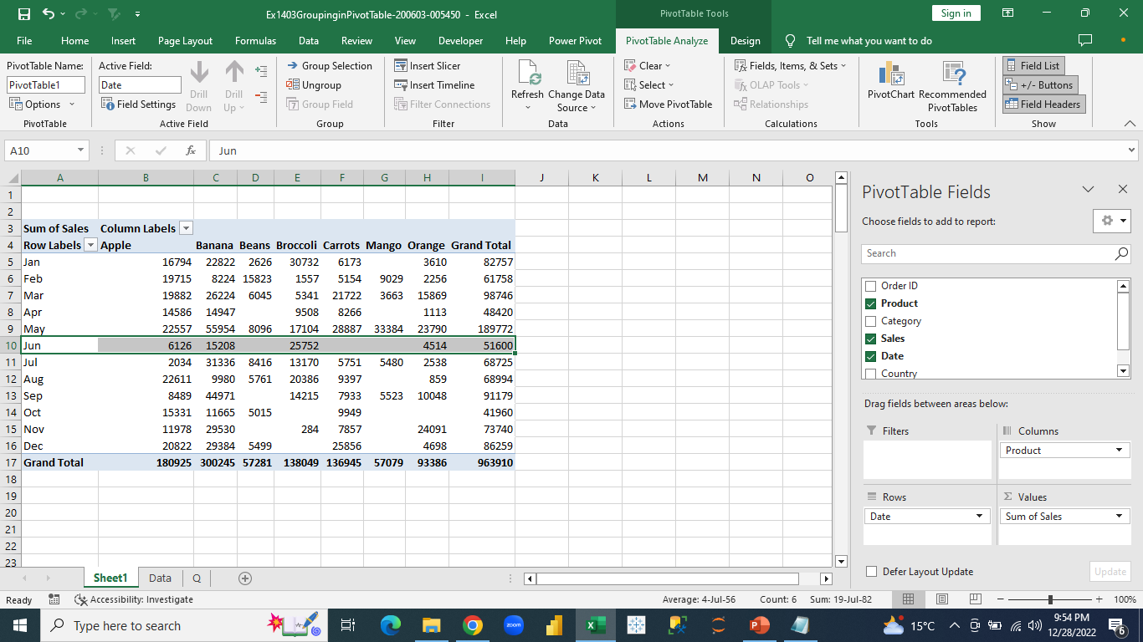
Grouping in Pivot Table
Advanced Excel
The table is grouped month-wise:
Notes:
After grouping the dates as months we can see the pivot table is presented as monthly wise sales for different products

Slide 52

Slicer
Advanced Excel
Slicers provide buttons that you can click to filter tables, or pivot tables. In addition to quick filtering, slicers also indicate the current filtering state, which makes it easy to understand what exactly is currently displayed.

Slide 53
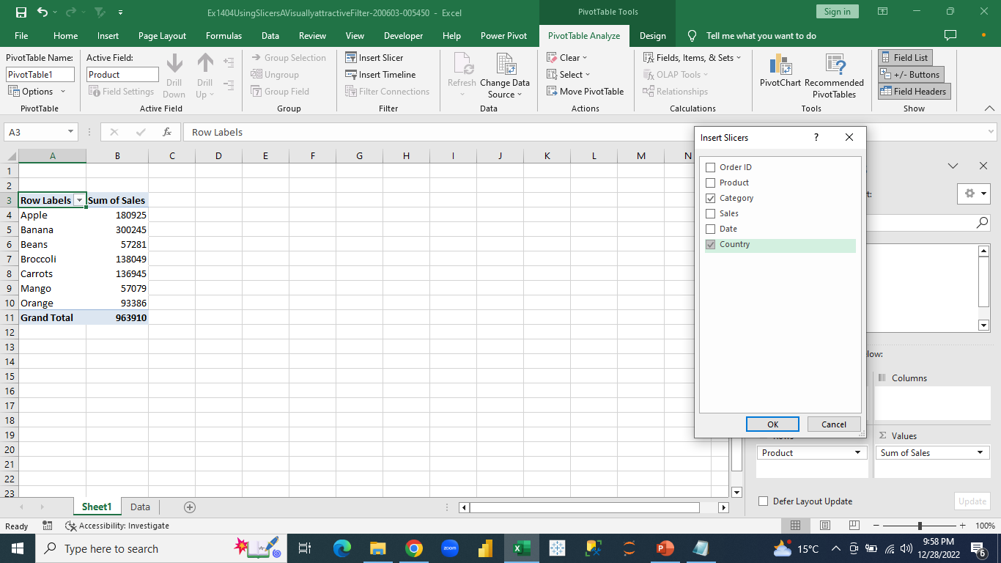
Slicer
Advanced Excel
Once the Pivot Table is created, we will create a Slicer.
Notes:
Once we click on the pivot table, we get to see the “pivot table analysis” tab and under the tab we select “insert slicer” tab. The “insert slicer” dialog box appears and we select the “category” and “country” columns for which we want to create the slicers.

Slide 54
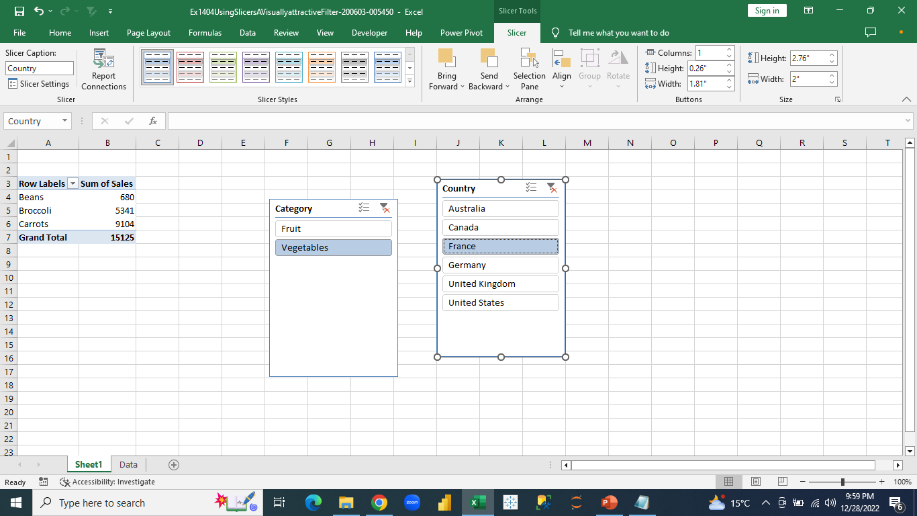
Slicer
Advanced Excel
The Slicers for both Country and Category have been created.
Notes:
We select different options from the slicers and based on that the data will be shown in the table.

Slide 55
Advanced Excel
In this class, we experimented with one of the most powerful tools in Excel; Pivot tables, and we observed their efficiency when it comes to summarizing large amounts of data.
With this understanding, we can figure out what we need from Pivot Tables and use them to solve more complex problems.
Let's conclude for today.
Notes:
Image Link: https://elements.envato.com/web-analytics-illustration-RF9E46H
Let’s meet (session day and time) to discuss how to create excel dashboards using pivot tables, charts, slicers, etc.

